Slide 2
Detecting face mask with A.I Project by Simone D’Antimo, Francesco Caldivezzi and Harjot Singh

Slide 3
PROJECT IDEA
Coronavirus disease (COVID-19) has significantly affected the daily life activities of people globally.
To prevent the spread of COVID-19, the World Health Organization has recommended people to wear face masks in public places.
Many states also impose that people wear masks in public places.

Slide 4
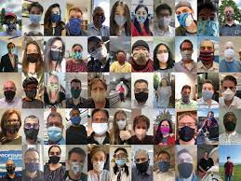
USEFULNESS OF OUR PROJECT
Manual inspection of people for wearing face masks in public places is a challenging task.
For this reason we’ve developed a system capable of detecting people not wearing face masks in a simple and autonomous way.
Our program works under several condition
Different types of masks
Facial occlusion (Hat, glasses, etc)
Different skin tone

Slide 5
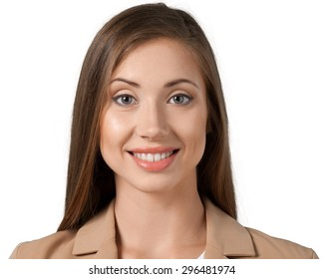
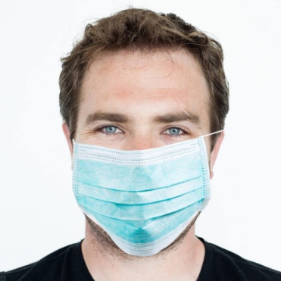
Model
Dataset
Two main classes :
Persons with mask (1914 samples)
Persons without mask (1918 samples)
Different persons for the two classes!!

Slide 6
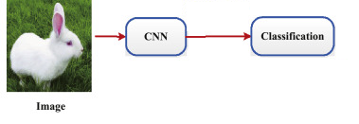
Model
Fine Tuning
Fine tuning is :
A powerful deep learning technique
A way to reuse a pre-trained network by:
Selecting a pre-trained model on some (huge) dataset
Substituting its fully-connected layers with other ones
Re-training the neural network obtained at the two previous steps on a the dataset of the current solving problem. (No change of the weights of the pre-trained model)
Very efficient compared to training from scratch a deep neural network
Widely used for similar tasks especially in imaged-related problems (CNN + ImageNet pre-trained dataset)

Slide 7
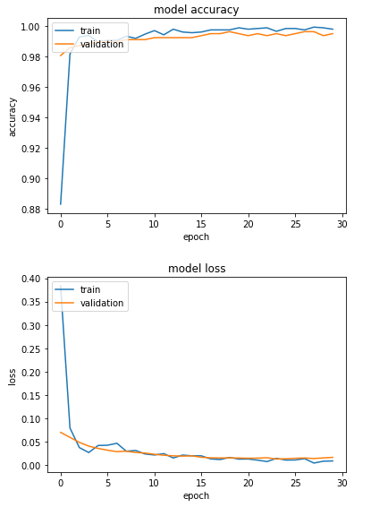
Model
ResNet50V2
ResNet50V2 is a deep neural network mostly used in CV for image recognition
Composed of 50 layers (last 4 fully connected)
In this project, last 4 layers were removed and substituted with 2 fully connected layers :
First layer composed of 1024 neurons with Relu activation function
Second layer composed of 2 neurons with sigmoid activation function
Regularization methods used for training :
Early Stopping
Data Augmentation
Validation on hyperparameters

Slide 8
Program
Load models
Detect faces
Detect masks
Draw boxes around faces
Take a frame from the video stream

Slide 9
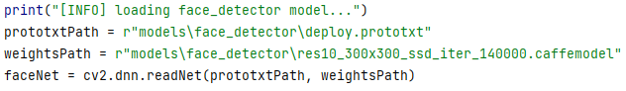

Program
Load models
Load models
1. Load the face_detector:
Detect faces
Detect masks
Draw boxes around faces
Take a frame from the video stream
We used pretrained opencv_3rdparty DNN, by opencv team: link:res10_300x300_ssd_iter_140000.caffemodel
2. Load the mask_detector:

Slide 10
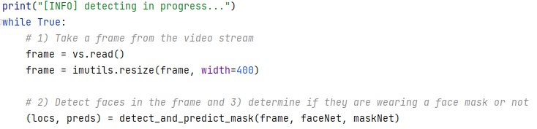
Program
1) Take a frame from the video stream
Load models
2) Detect faces
4) Draw boxes around faces
1) Take a frame from the video stream
3) Detect masks

Slide 11
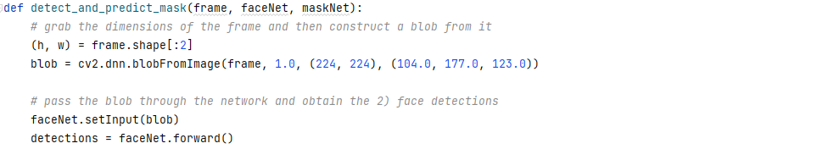
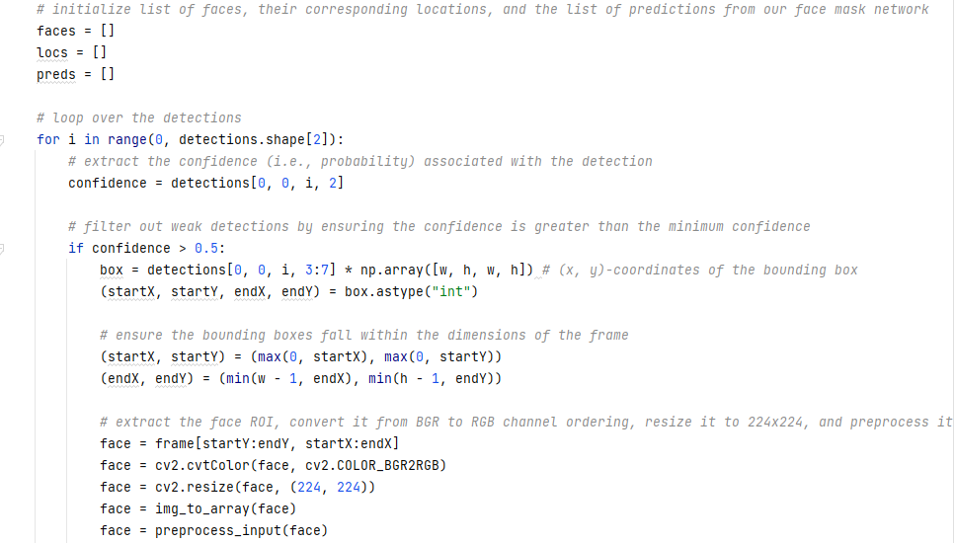

Program
2) Detect faces
Load models
2) Detect faces
4) Draw boxes around faces
1) Take a frame from the video stream
3) Detect masks

Slide 12
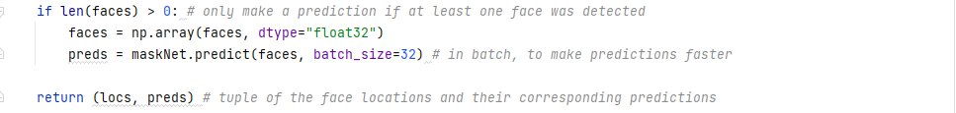
Program
3) Detect masks
Load models
2) Detect faces
4) Draw boxes around faces
1) Take a frame from the video stream
3) Detect masks

Slide 13
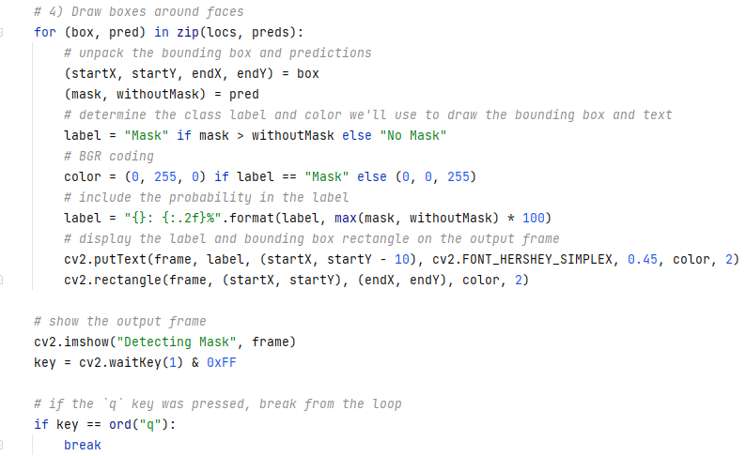
Program
Complete
Load models
2) Detect faces
4) Draw boxes around faces
1) Take a frame from the video stream
3) Detect masks

Slide 14
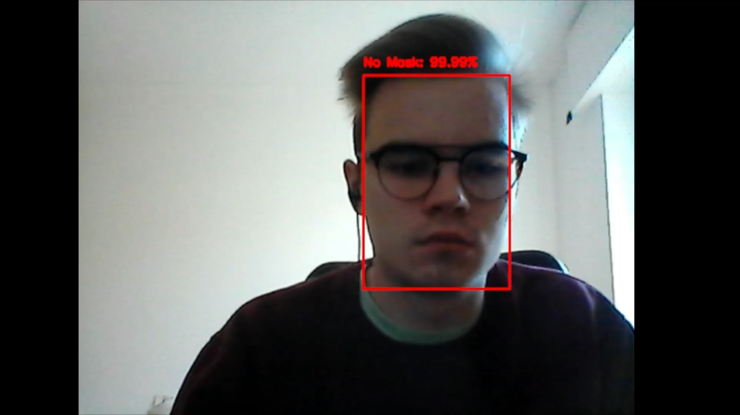
DEMO

